Slide 1
ACSA Strategic Plan
2019 - 2020

Slide 2
ACSA Mission
The Association of California School Administrators is the driving force for an equitable, world-class education system and
the development and support of inspired educational leaders who meet the diverse needs of all California students.

Slide 3
ACSA Strategic Plan 3 Key Areas
Member Development and Support
Advocacy and Influence
ACSA Organizational Development and Sustainability

Slide 4
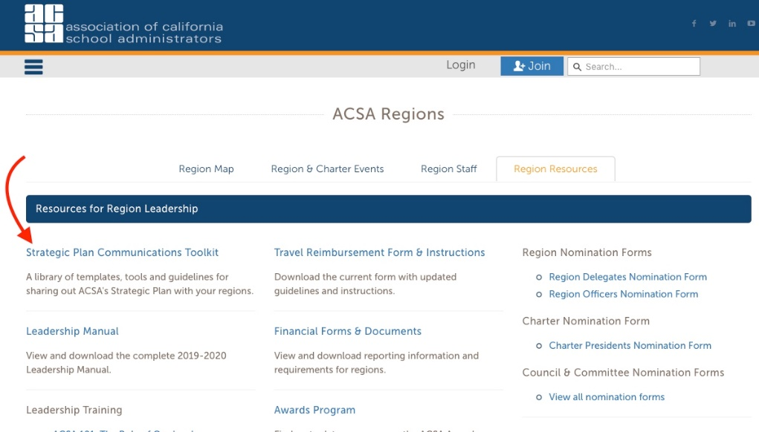
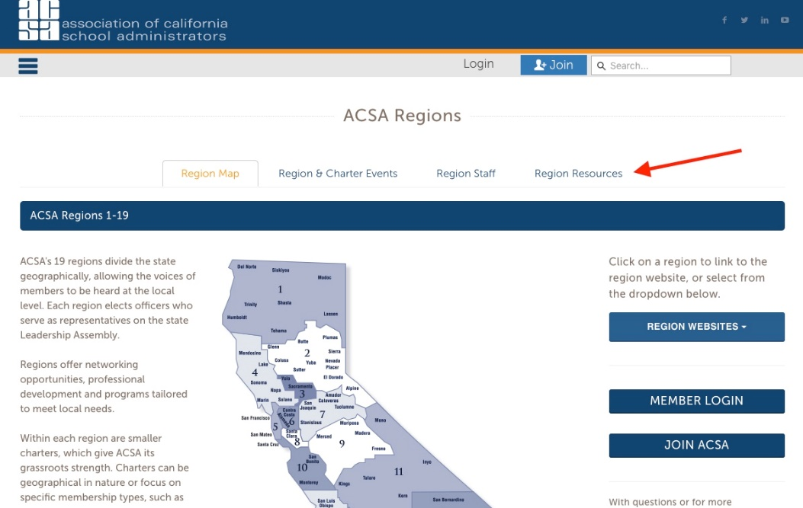
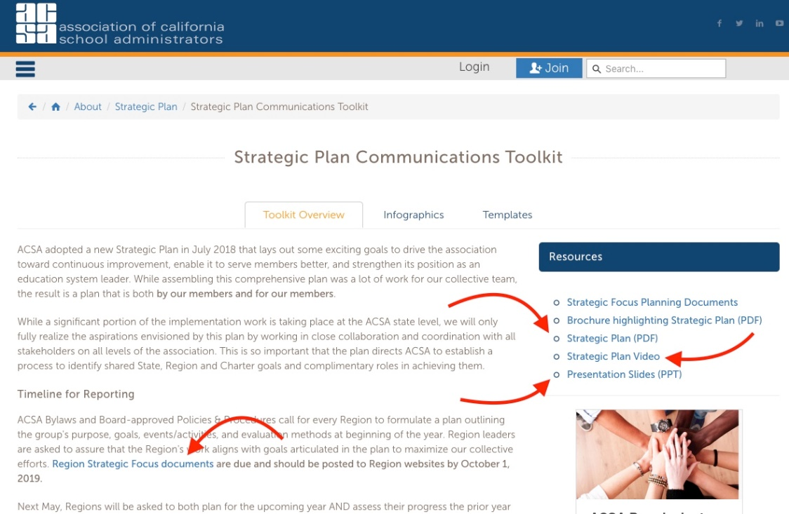
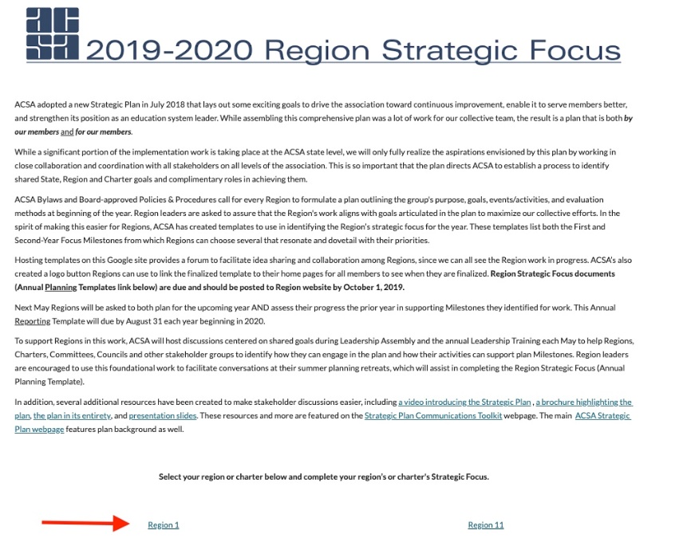
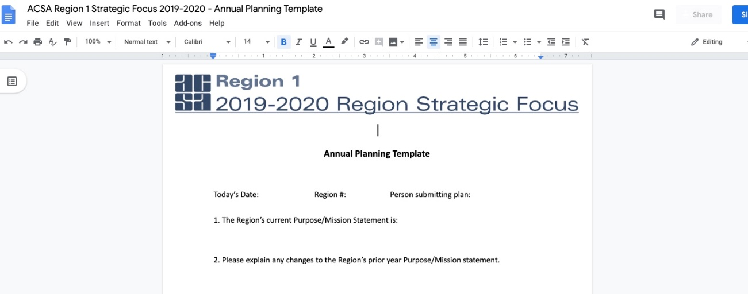
Local Strategic Plan Engagement Resources

Slide 5
We Are All ACSA and This Is OUR Strategic Plan
Our membership not only developed the plan but helped the board sequence our annual milestones
Why has the board asked the regions to complete the “Annual Planning Template” and submit by 10/1?
Milestone Y. A process is in place to identify on a regular basis shared state, region and charter goals, complementary roles in achieving them and a system for reporting and accountability

Slide 6
ACSA Strategic Plan Year 2 Focus Milestones
MEMBER DEVELOPMENT & SUPPORT Issue/Milestones Leadership Development Milestones: B, C, D PD Content Milestones: E PD Delivery/Reinforcement Milestones: I, J Professional Resources Milestones: K, L Member Networking & Collaboration Milestones: District/County/School Site Support Services Milestones: N | ADVOCACY & INFLUENCE Issue/Milestones ACSA Leadership Role Milestones: R Grassroots Advocacy and Influence Milestones: T, U Media Relations Milestones: W | ORGANIZATIONAL DEVELOPMENT & SUSTAINABILITY Issue/Milestones Alignment and Accountability Milestones: Member Outreach and Engagement Milestones: EE Member Communication Milestones: GG, HH, II Sustainability Milestones: JJ

Slide 7
Member Development and Support LEADERSHIP DEVELOPMENT
Provide engaging, career-long leadership development opportunities for all members.
Year 1: 2018-19 |  | Year 2: 2019-20 |  | Year 3: 2020-21
A | Strategy to identify and support leadership development along a career pathway - pre-certification to retirement.
 |  | B | Implementation of supports at each career stage is underway.
 |  | C | A focus on leadership skills (including advocacy/influence and equity) has been integrated into all professional development offerings.
 |  | D | A system is in place that leverages collective expertise of members to support leadership development

Slide 8
Member Development and Support professional development – content
Ensure the content of ACSA professional development offerings remains relevant to changing member needs and professional issues.
Year 1: 2018-19 |  | Year 2: 2019-20 |  | Year 3: 2020-21
 |  | E | A system is in place to regularly update the content of ACSA professional development offerings that includes input from members.

Slide 9
Member Development and support professional development – delivery/reinforcement
Improve member access to convenient, ongoing development opportunities that reflect the latest trends in professional learning.
Year 1: 2018-19 |  | Year 2: 2019-20 |  | Year 3: 2020-21
 |  | I | ACSA has explored and tested strategies to reinforce learning and support members in applying and demonstrating knowledge acquired.
 |  | J | Members are recognized when they gain new competencies and reach new professional development milestones.

Slide 10
Member Development and support professional practice resources
Make available easy-to-access resources addressing the latest research, tools and information pertinent to the role of the educational leader.
Year 1: 2018-19 |  | Year 2: 2019-20 |  | Year 3: 2020-21
 |  | K | Members are accessing the online Resource Hub on a regular basis to help address daily professional challenges.
 |  | L | Content on the Resource Hub is increasingly member-directed and vetted to address the most critical needs.

Slide 11
Member Development and support member networking and collaboration
Build dynamic professional communities where members can learn and collaborate.
Year 1: 2018-19 |  | Year 2: 2019-20 |  | Year 3: 2020-21

Slide 12
Member Development and support DISTRICT/COUNTY/SCHOOL SITE SUPPORT SERVICES
Better connect the value of ACSA to administrators at the site, county and district levels, tailoring ACSA services and engagement opportunities to the different needs and dynamics of each area as identified by state and local indicators.
Year 1: 2018-19 |  | Year 2: 2019-20 |  | Year 3: 2020-21
 |  | N | Differentiated assistance has been developed to meet top needs based on state and local indicators.

Slide 13
ADVOCACY AND INFLUENCE Acsa in a leadership role
ACSA is proactive in identifying and engaging stakeholders around current and emerging educational issues.
Year 1: 2018-19 |  | Year 2: 2019-20 |  | Year 3: 2020-21
 |  | R | ACSA has built and nurtured partnerships, including appropriate non-education related partners, to address issues that impact student learning, in and outside of the classroom.

Slide 14
ADVOCACY AND INFLUENCE grassroots advocacy and influence
Amplify the voice of the profession at the local, state and federal levels by fully leveraging the influence of educational leaders
Year 1: 2018-19 |  | Year 2: 2019-20 |  | Year 3: 2020-21
 |  | T | ACSA members are empowered to organize education stakeholders through ongoing training, tools and support.
 |  | U | State, regions and charters have developed and are implementing year-round strategies for communication and engagement of elected officials and community stakeholders.

Slide 15
ADVOCACY AND INFLUENCE media relations
Raise ACSA’s reputation as the authority on education issues and as an influential spokesperson at the local, state and federal levels
Year 1: 2018-19 |  | Year 2: 2019-20 |  | Year 3: 2020-21
 |  | W | Spokespersons have been identified in each region (starting with the VPLAs) and training is being provided on a regular basis to support effective media relations and communication of key messages.

Slide 16
ORGANIZATIONAL DEVELOPMENT AND SUSTAINABILITY ORGANIZATIONAL ALIGNMENT AND ACCOUNTABILITY
Tap the full potential of ACSA to effect positive change for the profession and for students through better alignment of roles, goals and resources at all levels of the Association.
Year 1: 2018-19 |  | Year 2: 2019-20 |  | Year 3: 2020-21

Slide 17
ORGANIZATIONAL DEVELOPMENT AND SUSTAINABILITY MEMBER OUTREACH AND ENGAGEMENT
Provide members with a wide range of meaningful opportunities to contribute their diverse talent, experience and perspective to further the mission, goals and priorities of ACSA.
Year 1: 2018-19 |  | Year 2: 2019-20 |  | Year 3: 2020-21
 |  | EE | Organizational barriers to expanded member engagement have been identified and removed.

Slide 18
ORGANIZATIONAL DEVELOPMENT AND SUSTAINABILITY MEMBER communication
Raise member awareness of ACSA benefits, services and initiatives, and the overall value of ACSA membership and engagement.
Year 1: 2018-19 |  | Year 2: 2019-20 |  | Year 3: 2020-21
 |  | GG | An evaluation has been conducted to determine what is most important for ACSA to communicate through different channels and vehicles, and to different target audiences.
 |  | HH | ACSA continues to leverage technology to better inform and engage members across the state, and to customize information members receive.
 |  | II | A more comprehensive member database is being developed to better target member interests and preferences for communication.

Slide 19
ORGANIZATIONAL DEVELOPMENT AND SUSTAINABILITY sustainability
Sustain and grow ACSA’s human and financial resources to support evolving goals and priorities.
Year 1: 2018-19 |  | Year 2: 2019-20 |  | Year 3: 2020-21
 |  | JJ | Implement an ongoing cycle to evaluate and update the financial plan and to ensure uninterrupted delivery of ACSA services through a downturn.

Slide 20
Next Steps State ACSA
Support Regions/Charters and Committees/Councils
Develop Action Steps
Allocate Resources
Identify Performance Measures
Craft Communications and Resources

Slide 21
Next Steps Regions/Charters & Committees/Councils
Integrate Milestones into Planning
Complete Strategic Focus/Planning Template 10/1/19
Coordinate with other ACSA Groups
Support Milestone Objectives

Slide 22
Thank You
Members Make the Difference!

