Slide 1


ACSA Strategic Plan
2019 – 2020 State Committees & Councils

Slide 2

ACSA Mission
  The Association of California School Administrators is the driving force for an equitable, world-class education system and
  the development and support of inspired educational leaders who meet the diverse needs of all California students.

Slide 3
ACSA Strategic Plan 3 Key Areas
  Member Development and Support
  Advocacy and Influence
  ACSA Organizational Development and Sustainability

Slide 4

We Are All ACSA and This Is OUR Strategic Plan
Our membership not only developed the plan but helped the board sequence our annual milestones
Why has the board asked the committees and councils to complete the “Annual Planning Template” and submit by 10/1?
  Milestone AA. Committees and councils are supporting implementation of priorities in the Strategic Plan within their areas of expertise.

Slide 5

n. ‘hu·man cap·i·tal’
intangible collective resources possessed by individuals and groups within a given population. These resources include all the knowledge, talents, skills, abilities, experience, intelligence, training, judgment, and wisdom possessed individually and collectively, the cumulative total of which represents a form of wealth available to nations and organizations to accomplish their goals.
Source: www.britannica.com/topic/human-capital

Slide 6

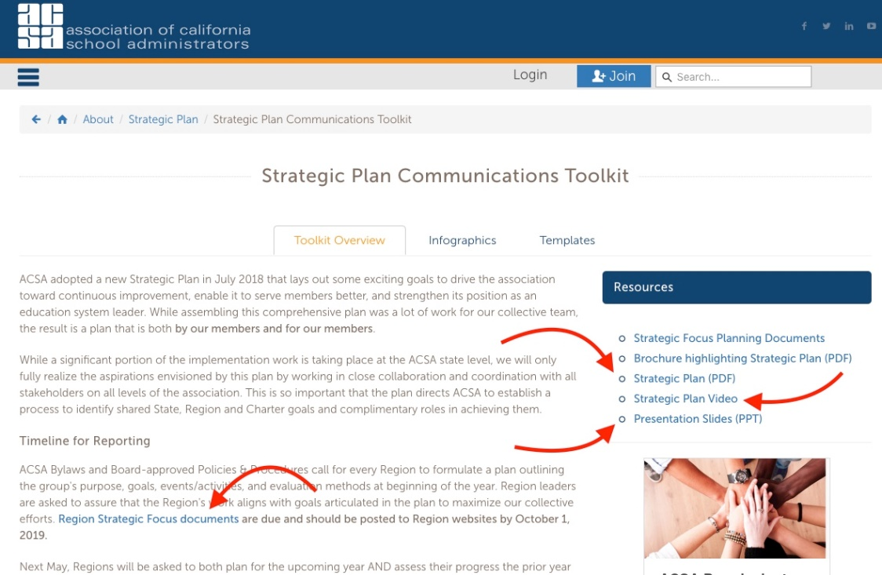
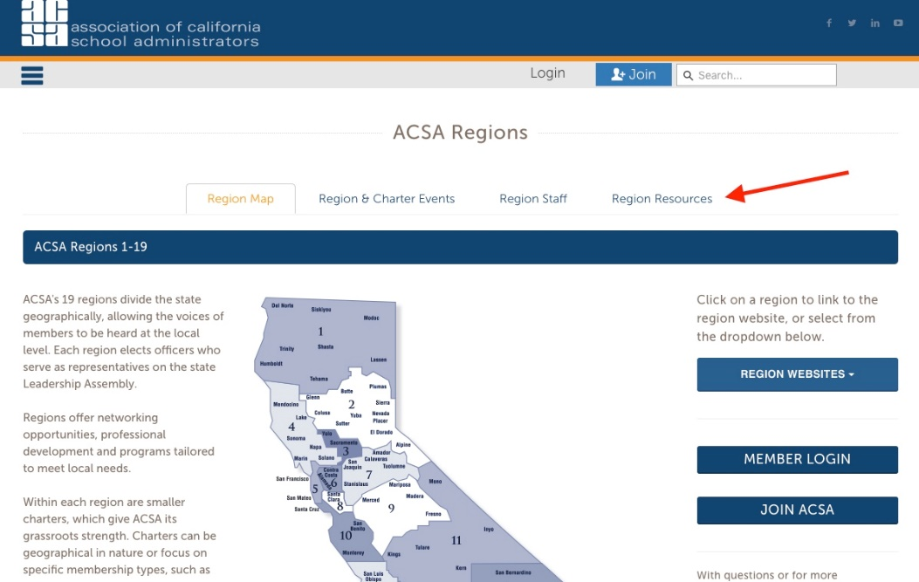
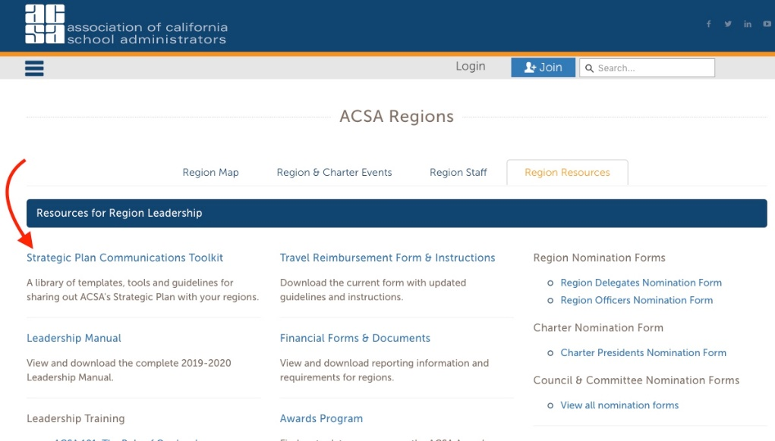
Strategic Plan Engagement Resources

Slide 7
Annual Planning Cycle for State Committees & Councils
Formulate Plan at Beginning of the Year for Board Consideration (Annual Planning Template due October 1 each year):
Purpose
Annual Goals
Planned Events, Activities, and Meetings
Evaluation Methods
Submit Report at Conclusion of the Year
(Annual Reporting Template due August 31 each year):
How well were annual goals met?
What events, activities, and meetings were held and what were the results?
What was learned through evaluation and how will it impact future planning?

Slide 8

ACSA Strategic Plan
Second Year Focus Milestones
MEMBER DEVELOPMENT & SUPPORT Issue/Milestones Leadership Development Milestones: B, C, D PD Content Milestones: E PD Delivery/Reinforcement Milestones: I, J Professional Resources Milestones: K, L Member Networking & Collaboration Milestones: District/County/School Site Support Services Milestones: N | ADVOCACY & INFLUENCE Issue/Milestones ACSA Leadership Role Milestones: R Grassroots Advocacy and Influence Milestones: T, U Media Relations Milestones: W | ORGANIZATIONAL DEVELOPMENT & SUSTAINABILITY Issue/Milestones Alignment and Accountability Milestones: Member Outreach and Engagement Milestones: EE Member Communication Milestones: GG, HH, II Sustainability Milestones: JJ

Slide 9
Member Development and Support
LEADERSHIP DEVELOPMENT
Provide engaging, career-long leadership development opportunities for all members.
Year 1: 2018-19 |  | Year 2: 2019-20 |  | Year 3: 2020-21
 |  | B | Implementation of supports at each career stage is underway.
 |  | C | A focus on leadership skills (including advocacy/influence and equity) has been integrated into all professional development offerings.
 |  | D | A system is in place that leverages collective expertise of members to support leadership development

Slide 10
Member Development and Support professional development – content
Ensure the content of ACSA professional development offerings remains relevant to changing member needs and professional issues.
Year 1: 2018-19 |  | Year 2: 2019-20 |  | Year 3: 2020-21
 |  | E | A system is in place to regularly update the content of ACSA professional development offerings that includes input from members.

Slide 11
Member Development and support professional development – delivery/reinforcement
Improve member access to convenient, ongoing development opportunities that reflect the latest trends in professional learning.
Year 1: 2018-19 |  | Year 2: 2019-20 |  | Year 3: 2020-21
 |  | I | ACSA has explored and tested strategies to reinforce learning and support members in applying and demonstrating knowledge acquired.
 |  | J | Members are recognized when they gain new competencies and reach new professional development milestones.

Slide 12
Member Development and support professional practice resources
Make available easy-to-access resources addressing the latest research, tools and information pertinent to the role of the educational leader.
Year 1: 2018-19 |  | Year 2: 2019-20 |  | Year 3: 2020-21
 |  | K | Members are accessing the online Resource Hub on a regular basis to help address daily professional challenges.
 |  | L | Content on the Resource Hub is increasingly member-directed and vetted to address the most critical needs.

Slide 13
Member Development and support member networking and collaboration
Build dynamic professional communities where members can learn and collaborate.
Year 1: 2018-19 |  | Year 2: 2019-20 |  | Year 3: 2020-21

Slide 14
Member Development and support
DISTRICT/COUNTY/SCHOOL SITE SUPPORT SERVICES
Better connect the value of ACSA to administrators at the site, county and district levels, tailoring ACSA services and engagement opportunities to the different needs and dynamics of each area as identified by state and local indicators.
Year 1: 2018-19 |  | Year 2: 2019-20 |  | Year 3: 2020-21
 |  | N | Differentiated assistance has been developed to meet top needs based on state and local indicators.

Slide 15
ADVOCACY AND INFLUENCE
Acsa in a leadership role
ACSA is proactive in identifying and engaging stakeholders around current and emerging educational issues.
Year 1: 2018-19 |  | Year 2: 2019-20 |  | Year 3: 2020-21
 |  | R | ACSA has built and nurtured partnerships, including appropriate non-education related partners, to address issues that impact student learning, in and outside of the classroom.

Slide 16
ADVOCACY AND INFLUENCE grassroots advocacy and influence
Amplify the voice of the profession at the local, state and federal levels by fully leveraging the influence of educational leaders
Year 1: 2018-19 |  | Year 2: 2019-20 |  | Year 3: 2020-21
 |  | T | ACSA members are empowered to organize education stakeholders through ongoing training, tools and support.
 |  | U | State, regions and charters have developed and are implementing year-round strategies for communication and engagement of elected officials and community stakeholders.

Slide 17
ADVOCACY AND INFLUENCE media relations
Raise ACSA’s reputation as the authority on education issues and as an influential spokesperson at the local, state and federal levels
Year 1: 2018-19 |  | Year 2: 2019-20 |  | Year 3: 2020-21
 |  | W | Spokespersons have been identified in each region (starting with the VPLAs) and training is being provided on a regular basis to support effective media relations and communication of key messages.

Slide 18
ORGANIZATIONAL DEVELOPMENT AND SUSTAINABILITY
ORGANIZATIONAL ALIGNMENT AND ACCOUNTABILITY
Tap the full potential of ACSA to effect positive change for the profession and for students through better alignment of roles, goals and resources at all levels of the Association.
Year 1: 2018-19 |  | Year 2: 2019-20 |  | Year 3: 2020-21

Slide 19
ORGANIZATIONAL DEVELOPMENT AND SUSTAINABILITY
MEMBER OUTREACH AND ENGAGEMENT
Provide members with a wide range of meaningful opportunities to contribute their diverse talent, experience and perspective to further the mission, goals and priorities of ACSA.
Year 1: 2018-19 |  | Year 2: 2019-20 |  | Year 3: 2020-21
 |  | EE | Organizational barriers to expanded member engagement have been identified and removed.

Slide 20
ORGANIZATIONAL DEVELOPMENT AND SUSTAINABILITY
MEMBER communication
Raise member awareness of ACSA benefits, services and initiatives, and the overall value of ACSA membership and engagement.
Year 1: 2018-19 |  | Year 2: 2019-20 |  | Year 3: 2020-21
 |  | GG | An evaluation has been conducted to determine what is most important for ACSA to communicate through different channels and vehicles, and to different target audiences.
 |  | HH | ACSA continues to leverage technology to better inform and engage members across the state, and to customize information members receive.
 |  | II | A more comprehensive member database is being developed to better target member interests and preferences for communication.

Slide 21
ORGANIZATIONAL DEVELOPMENT AND SUSTAINABILITY sustainability
Sustain and grow ACSA’s human and financial resources to support evolving goals and priorities.
Year 1: 2018-19 |  | Year 2: 2019-20 |  | Year 3: 2020-21
 |  | JJ | Implement an ongoing cycle to evaluate and update the financial plan and to ensure uninterrupted delivery of ACSA services through a downturn.

Slide 22
Steps in Progress
State ACSA
  Support Regions/Charters and Committees/Councils
  Develop Action Steps
  Allocate Resources
  Identify Performance Measures
  Craft Communications and Resources

Slide 23
Next Steps
Regions/Charters & Committees/Councils
  Integrate Milestones into Planning
  Complete Annual Planning Template (10/1)
  Coordinate with other ACSA Groups
  Support Milestone Objectives
  Complete your Annual Reporting Template (8/31)

Slide 24
Formulating the Group’s Annual Plan
    Review Purpose Statement and Propose Changes if Needed
    Clarify Goals and Objectives for the Year
    Decide on Events, Activities, and Meetings
    Define Evaluation Methods
    Assure the Group’s Work Supports the Strategic Plan
      Identify Milestones that Dovetail with Goals and Objectives
      Decide How the Group can Support these Milestones

Slide 25
Thank You
Members Make the Difference!

